Slide 1


Slide 2
Junior 3 year old
Nominated All-Ontario

Slide 3
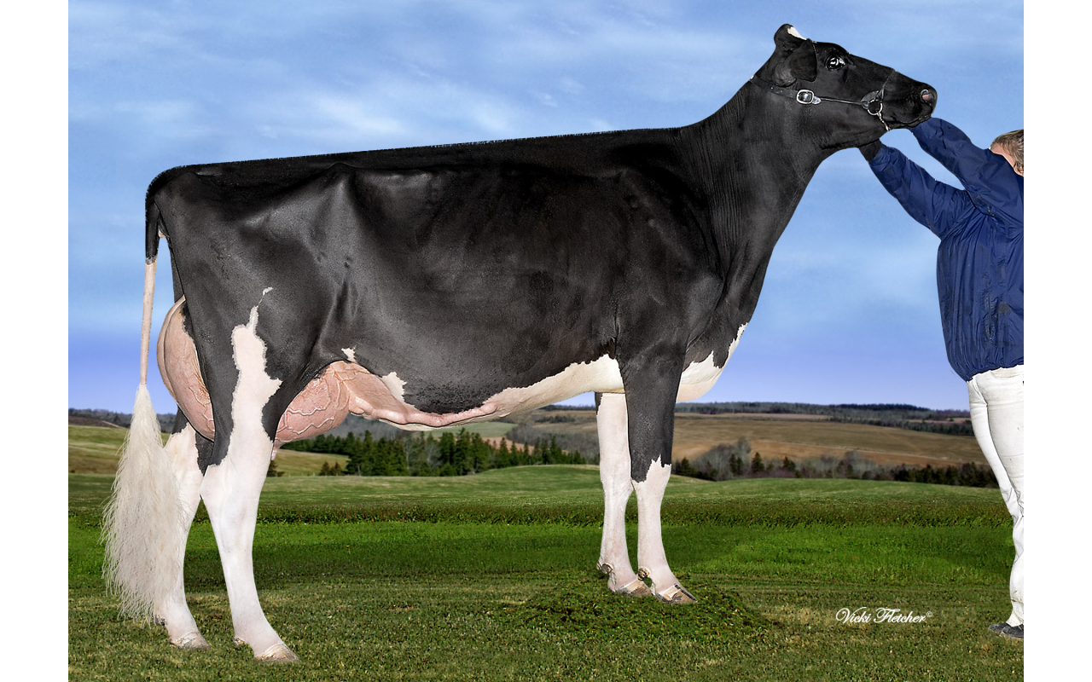
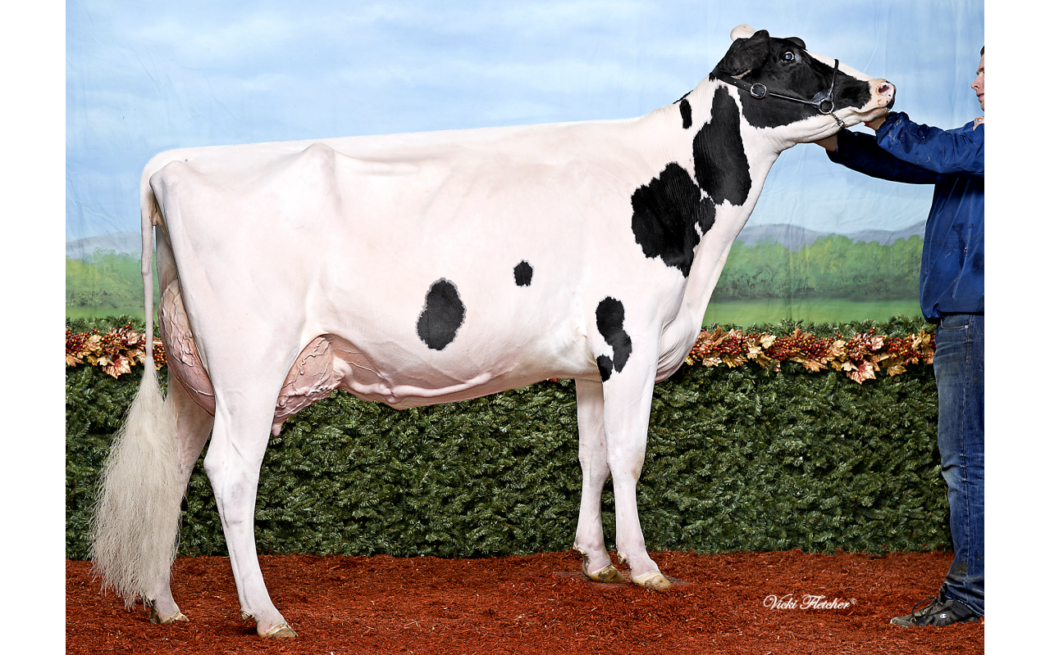
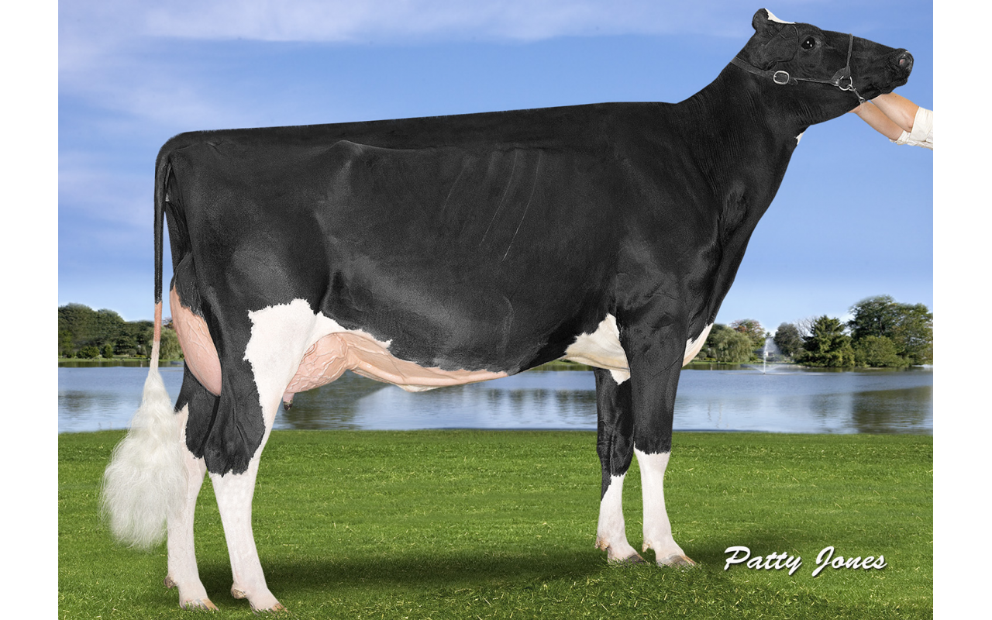
Junior 3 year old
Nominated All-Ontario
Signature Sids Gold
Hodglynn Sid Lucille
Crovalley Gold Akitkat
Signature Holsteins
Hodglynn Holsteins and Starbrite Holsteins
Crovalley Holsteins

Slide 4
Junior 3 year old
Honorable Mention All-Ontario 2016

Slide 5
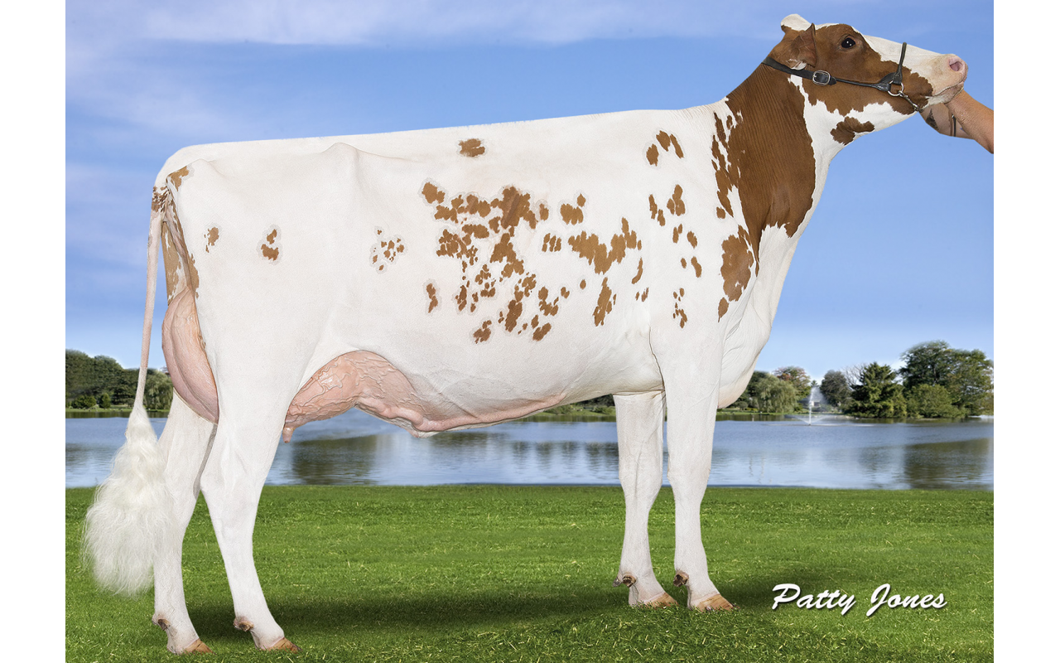
Junior 3 year old
Honorable Mention All-Ontario 2016
Trinal Barbwire Kelly
Century Star Holsteins

Slide 6
Junior 3 year old
Reserve All-Ontario 2016

Slide 7
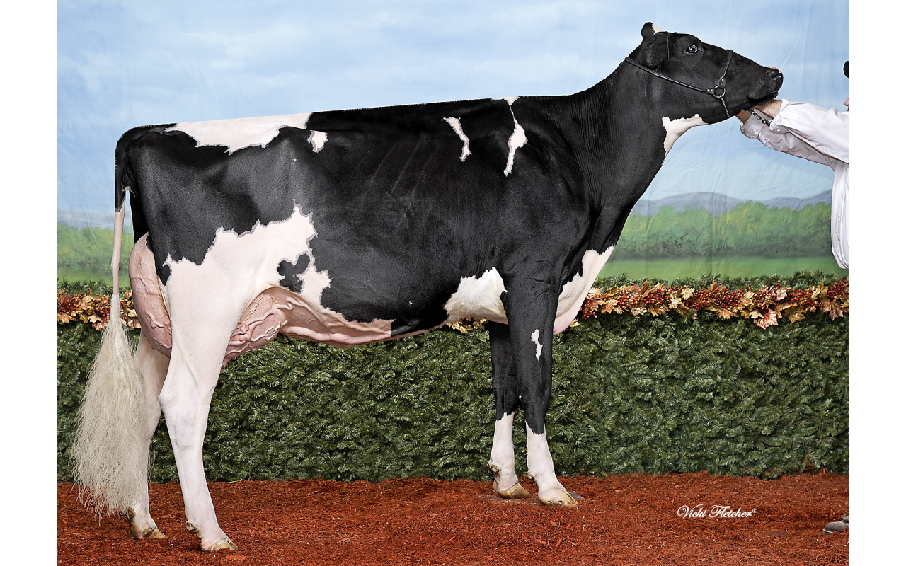
Junior 3 year old
Reserve All-Ontario 2016
Jeanlu Stanleycup Alexis
Signature Holsteins

Slide 8
Junior 3 year old
All Ontario 2016

Slide 9
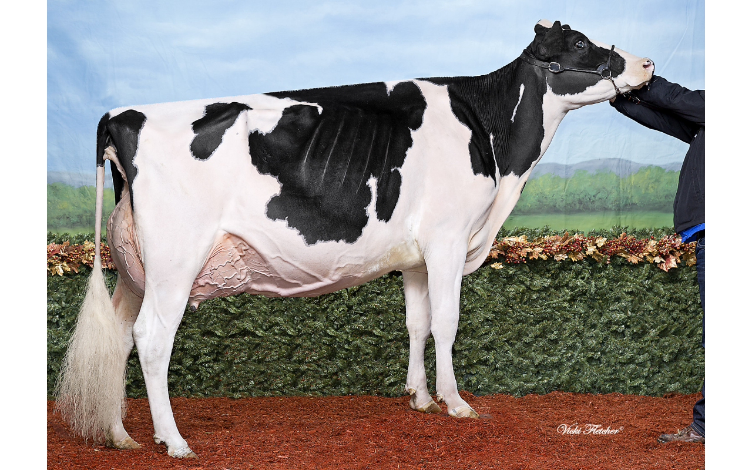
Junior 3 year old
All Ontario 2016
Loyalyn Duplex Vanessa
Clarkvalley Holsteins, JM Valley Holstein and Mt. Elgin Dairy Farms

